Slide 1


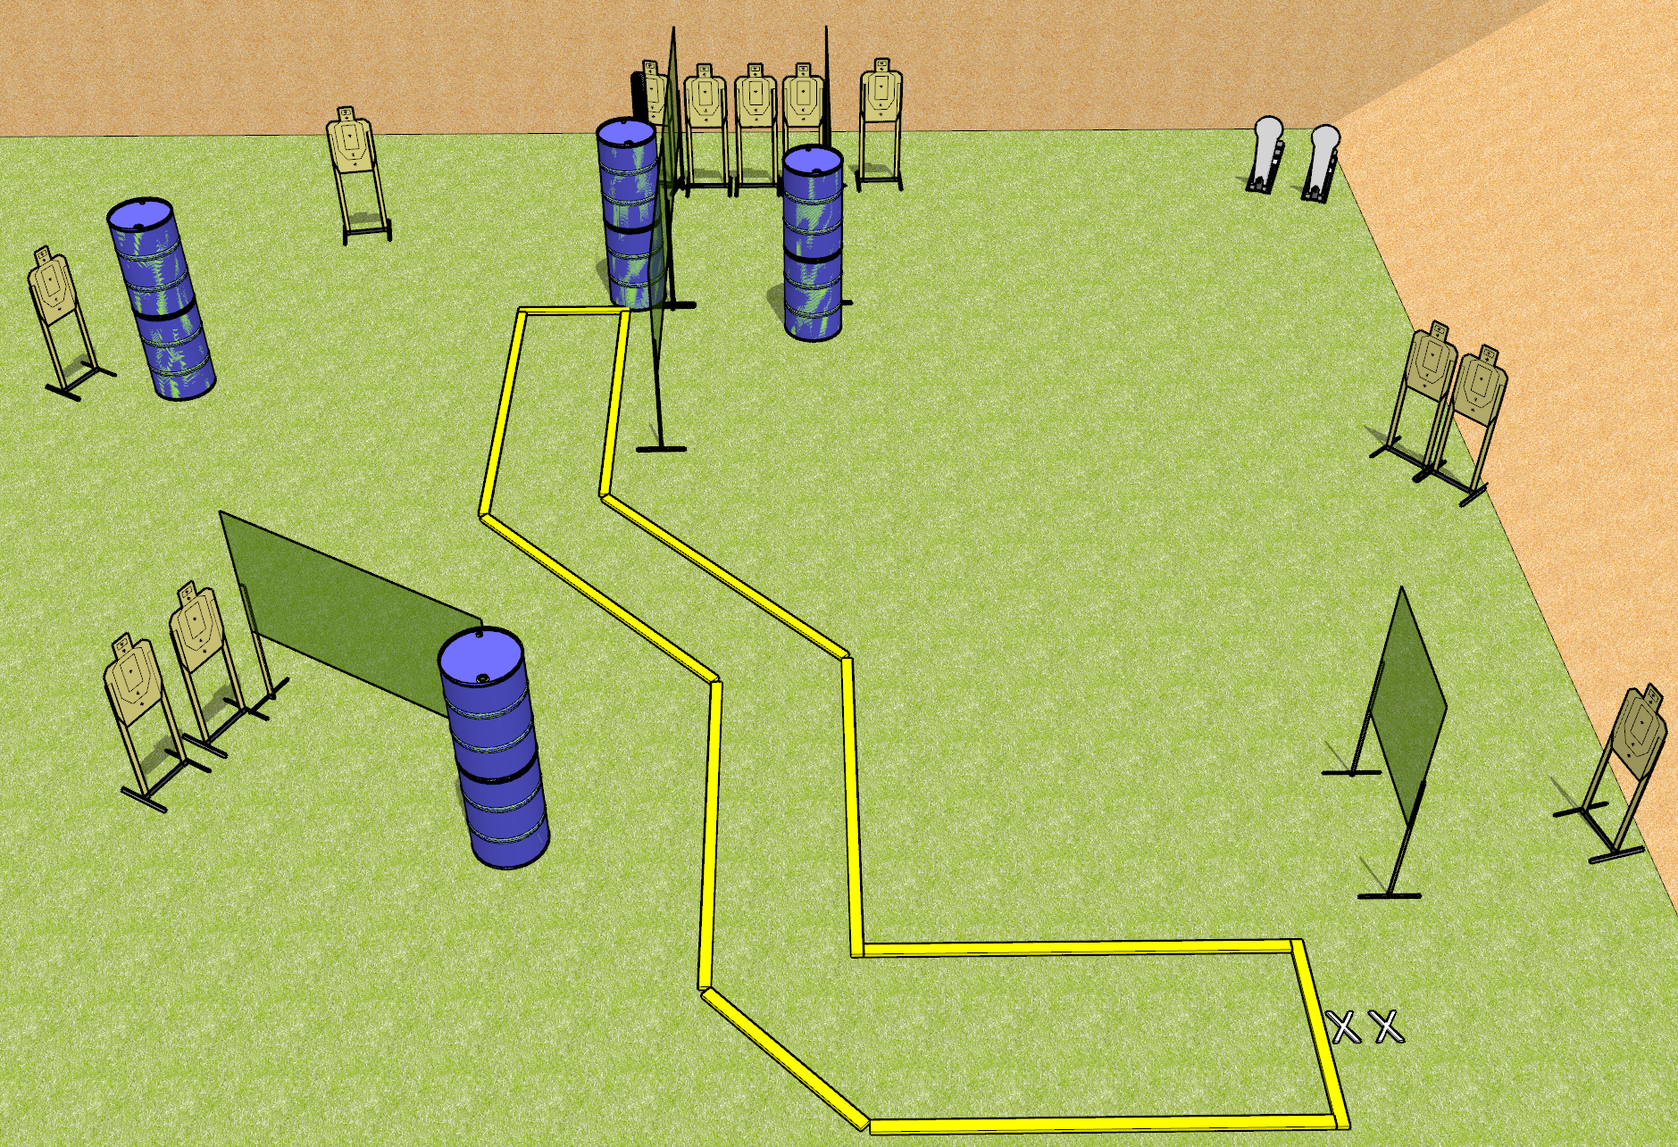
 | Dothan Gun Club – USPSA Match Check Your Corners Course Designer : Drew Coleman
Round Count 26 rounds 12 USPSA 2 Colt poppers
Equipment List 3 medium fault lines 9 wall feet 8 10’ fault lines

Slide 2
Check Your Corners
Written Stage Briefing
Check Your Corners is a 26 round, 130 point, Comstock course of fire. There are 12 USPSA targets and 2 colt poppers. The best 2 hits on paper will score, and steel must fall to score. The start signal is audible.
Handgun start position is toes on X’s, wrists below belt. Handgun is loaded and holstered.
PCC start position is toes on X’s, stock on belt. Loaded carbine is held with both hands, safety on.
On start signal, engage targets as they become available from within the shooting area.

